Slide 1
Earnings-related Pension System in Graphs and Figures
The slideshow includes key information of the Finnish earnings-related pension system.
Updated: 13th December 2024

Slide 2
Pension System and Governance
1

Slide 3
Social security insurance in 2022
44,4 bnEUR
Health Insurance
5.1 bnEUR
Employees’ group life Insurance
0.02 bnEUR
Workers’ Compensation Insurance
0.5 bnEUR
Pension Insurance
35.2 bnEUR
Unemployment Insurance
3.6 bnEUR
National pension
2.5 bnEUR
Earnings-related pension
31.4 bnEUR
Other
1.3 bnEUR

Slide 4
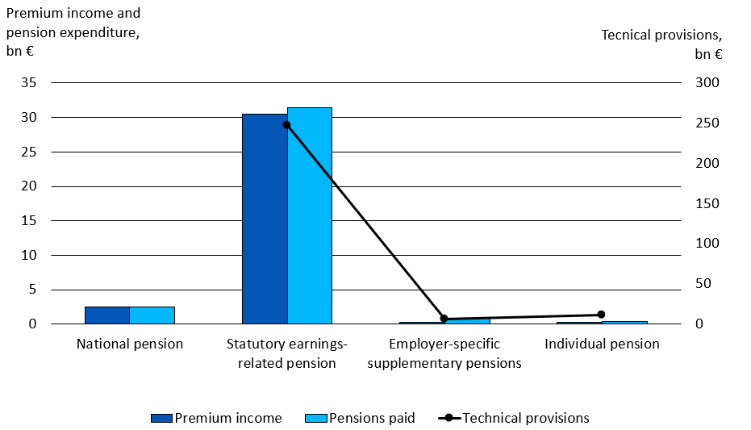
Pension insurance in Finland in 2022

Slide 5
Basic pension provision
Earnings-related
pension
Maintains the attained income level to a reasonable degree
National pension and guarantee pension
Guarantee a minimum income
TOTAL
PENSION
TYÖELÄKE
KANSANELÄKE
JA TAKUUELÄKE
KOKONAIS-
ELÄKE
Vähimmäis-
toimeentulon
turvaaminen

Slide 6
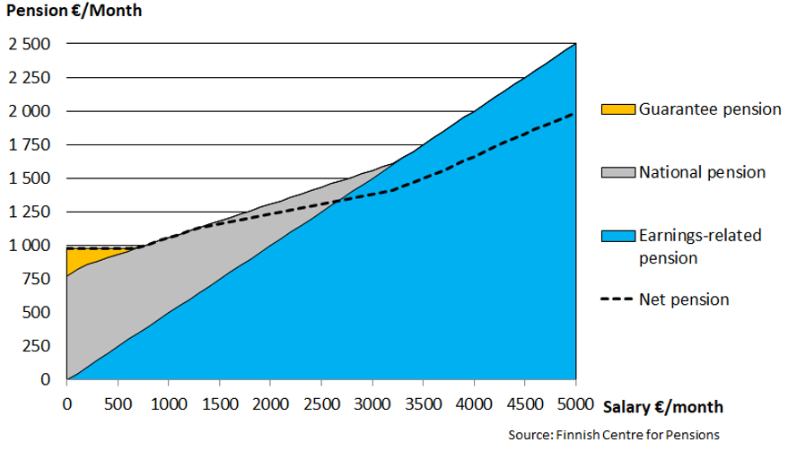
Total pension in 2024

Slide 7
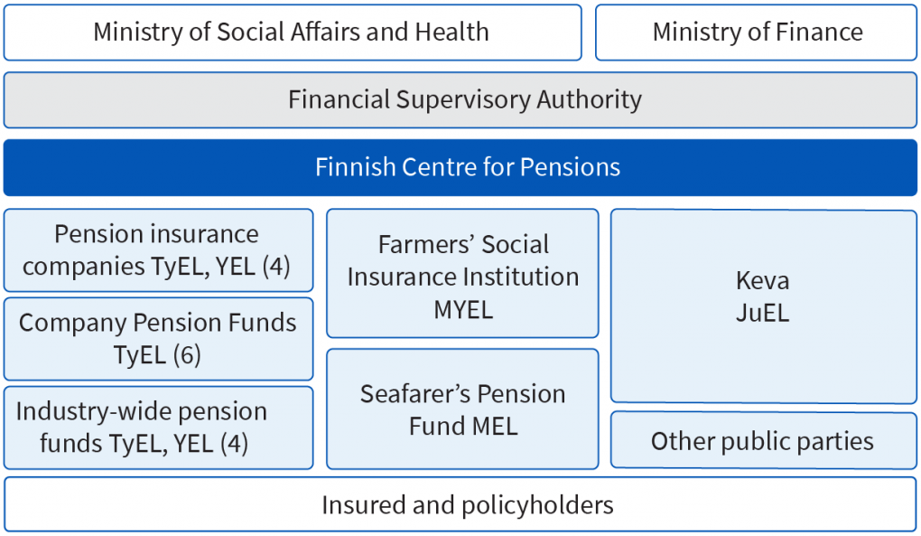
Execution in Earnings-related Pension System

Slide 8




Preparation and coming into force of earnings-related pension acts
STM
prepares a bill
Employers
Result of the
negotiations
Employees
Parlament
debates the bill
The self-employed
The Finnish pension
Alliance TELA
Authorised pension
providers
STM
The Ministry of
Social Affairs
and Health
ETK
The Finnish Centre for Pensions
The president
ratifies the bill

Slide 9
Determining the Pension
2

Slide 10
Basic pension provision
Earnings-related
pension
Maintains the attained income level to a reasonable degree
National pension and guarantee pension
Guarantee a minimum income
TOTAL
PENSION
TYÖELÄKE
KANSANELÄKE
JA TAKUUELÄKE
KOKONAIS-
ELÄKE
Vähimmäis-
toimeentulon
turvaaminen

Slide 11
Total pension in 2024

Slide 12
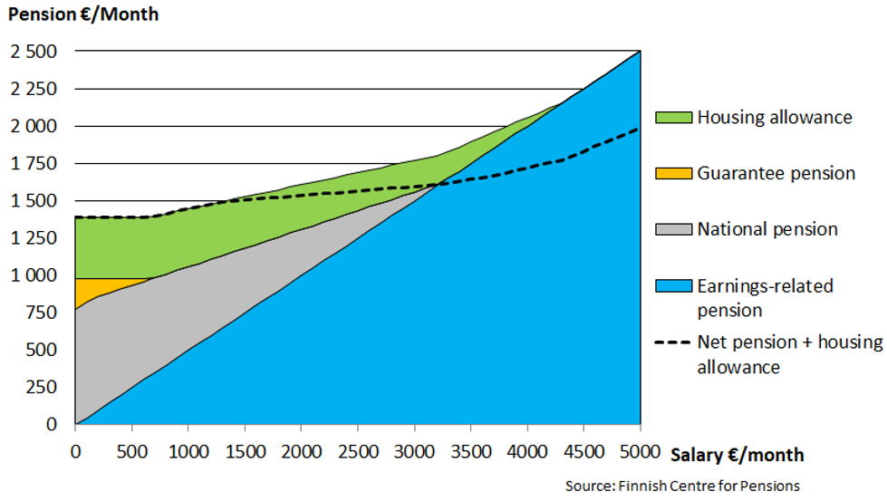
Total pension in 2024, including housing allowance

Slide 13
Pension accrues from work
As of the beginning of 2017
ELINAIKA-
KERROIN
Life
expectancy
coefficient
Earnings-
related
pension
Annual
earnings
Accrual
rate
TYÖANSIOT
Pension accrues at a rate of 1.5% of the gross annual wages
For those aged 53–62 years: at a rate of 1.7% of the gross annual wages until the end of 2025 (accrual during transition period).
If the pension is taken after reaching the retirement age, the pension will be increased by 0.4% per month.

Slide 14
Retirement age rises by birth group
Year of birth | Retirement age | Age when insurance obligation and pension accrual end
1954 | 63 years | 68
1955 | 63 years 3 months | 68
1956 | 63 years 6 months | 68
1957 | 63 years 9 months | 68
1958 | 64 years | 69
1959 | 64 years 3 months | 69
1960 | 64 years 6 months | 69
1961 | 64 years 9 months | 69
1962–1964 | 65 years | 70

Slide 15
Age limits of earnings-related pension benefits
Benefit | Year of birth | Right to pension in age
Old-age pension |  | As of age group’s retirement age
Partial old-age pension | 1949–1963 | 61–
 | 1964 | 62–
 | 1965– | 3 years before reaching the retirement age (follows life expectancy)
Disability pension (full or partial) |  | 17– age group’s retirement age
Years-of-service pension | 1955–1964 | 63– age group’s retirement age
 | 1965– | 2 years before reaching the retirement age (follows life expectancy)
Survivor’s pension
- Child |  | 0–20
- Surviving spouse, if children |  | No age limit
- Surviving spouse, no children |  | 50–
Vocational rehabilitation |  | 17– age group’s retirement age

Slide 16
Index adjustments secure pension level
The earnings are adjusted with the wage coefficient to the level of the starting moment of the pension.
Earnings-related pensions in payment are adjusted annually with the earnings-related pension index.
National pensions in payment are adjusted annually by Kela with the national pension index.
Index | 2020 | 2021 | 2022 | 2023 | 2024
Wage coefficient | 2.0 % | 1.3 % | 2.5 % | 3.8 % | 5.1 %
Earnings-related pension index | 1.2 % | 0.5 % | 2.3 % | 6.8 % | 5.7 %
National pension index | 1.0 % | 0.4 % | 2.1 % | 7.8 % | 5.9 %

Slide 17
Pension Level
3

Slide 18
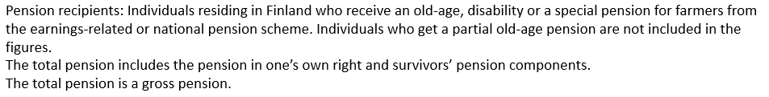
Average total pension on 31 Dec. 2023
 | Men | Women | All
Average total pension EUR/month | 2,216 | 1,779 | 1,977
- Earnings-related pension component | 2,073 | 1,621 | 1,826
- National pension component | 122 | 146 | 135
- Special protection pension component* | 20 | 13 | 16
Number of pension recipients | 685,000 | 826,000 | 1,511,000
*Occupational Accidents, Injuries and Diseases Act, Motor Liability Insurance Act, Act on Compensation for Military Accidents and Service-Related Illnesses, Act on Compensation for Accidents and Service-Related Illnesses in Crisis Management Duties and the Compensation for Military Injuries Act.

Slide 19
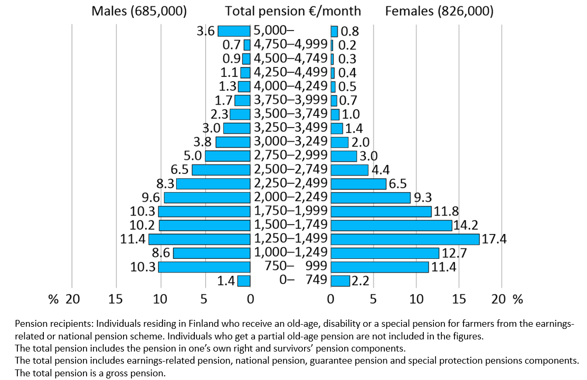
Distribution of total pension received in one’s own right of persons residing in Finland 31 Dec. 2023

Slide 20
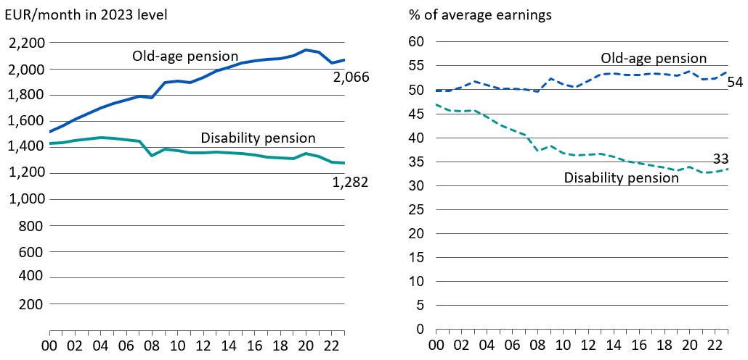
Average total pension and its ratio to average earnings in 2000–2023

Slide 21
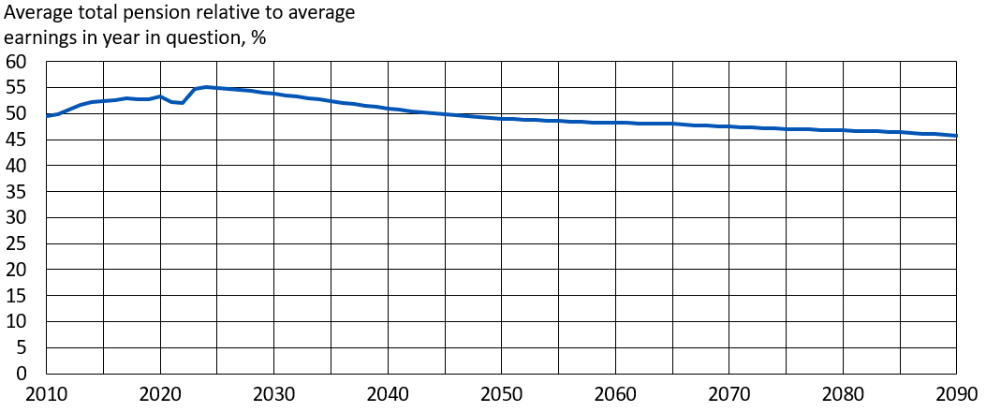
Average total pension relative to average earnings in 2010–2090, %
The estimated development of the average total pension is based on the long-term projection compiled and published (in Finnish) in October 2022 (in English in early 2023). Statutory pensions in Finland – Long-term projections 2022 (Reports 03/2023) Finnish Centre for Pensions
The total pension includes earnings-related pensions, national pensions and pensions based on special provisions. The average earning is based on data on the insured individuals’ income from work and the number of insured persons in the earnings and accrual register of the earnings-related pension system.

Slide 22
Pension Expenditure
4

Slide 23
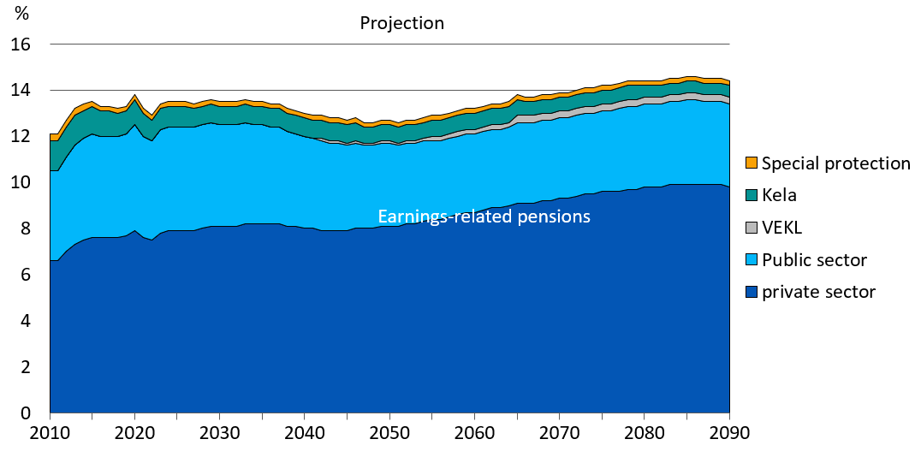
Pension expenditure, per cent of GDP in 2010–2090
Source: Statutory pensions in Finland – Long-term projections 2022 (Reports 03/2023) Finnish Centre for Pensions

Slide 24
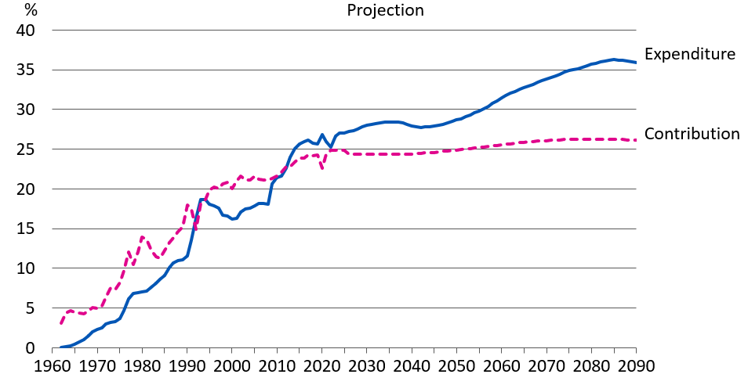
Pension expenditure and contribution rates in proportion to the wage sum under the Employees Pensions Act (TyEL) in 1962–2090
Source: Statutory pensions in Finland – Long-term projections 2022 (Reports 03/2023) Finnish Centre for Pensions

Slide 25
Insured for Earnings-related Pension Benefits
5

Slide 26
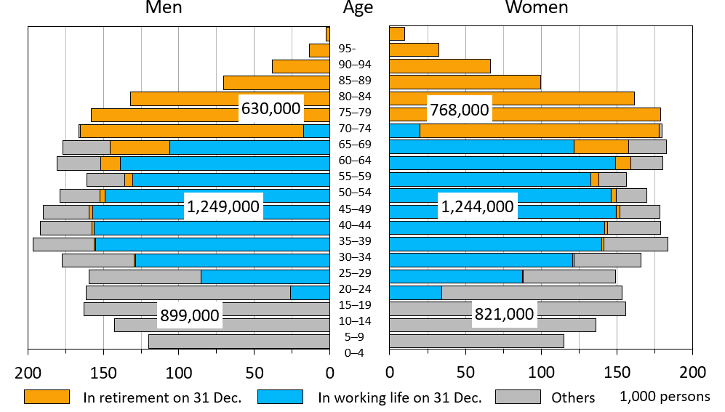
Distribution of population in terms of work and earnings-related pension per 31 Dec. 2023

Slide 27
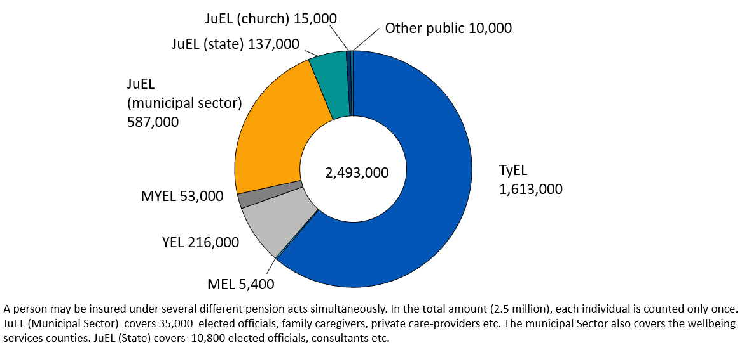
Insured persons in employment or self employment on 31 Dec. 2023, by pension act

Slide 28
Pension Recipients
6

Slide 29
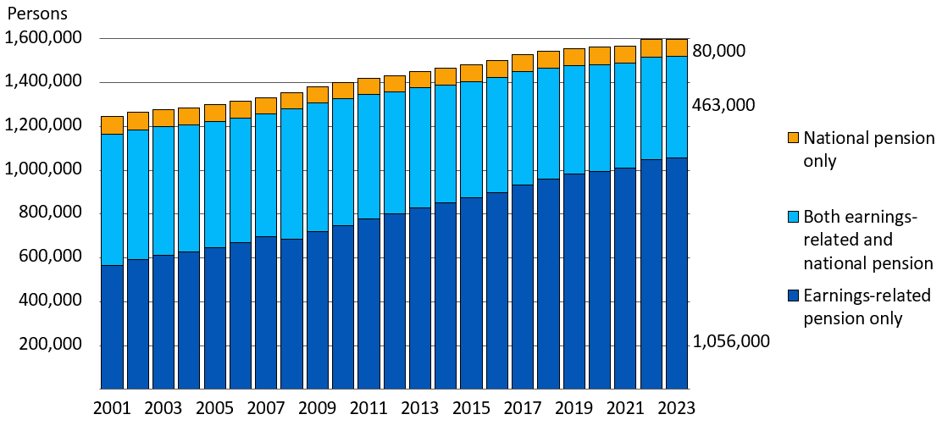
Pension recipients by pension structure in 2001–2023

Slide 30
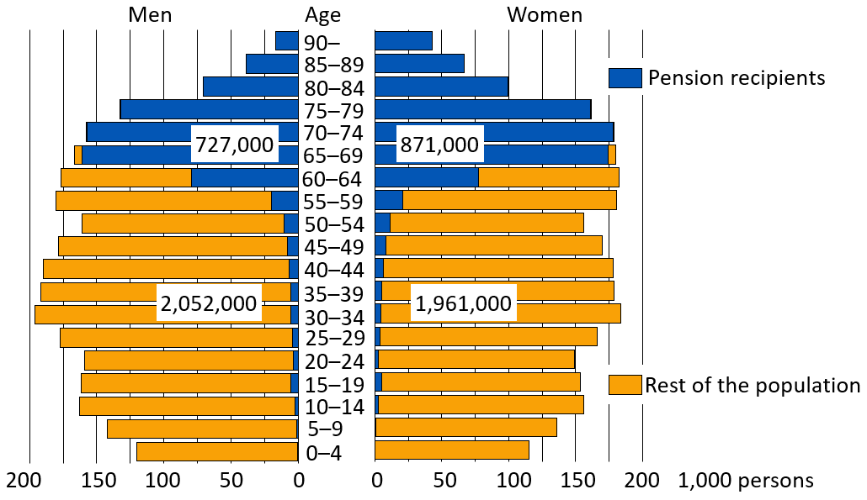
Total population and pension recipients on 31 Dec. 2023

Slide 31
Retirees on Earnings-related Pensions and Effective
Retirement Age
7

Slide 32
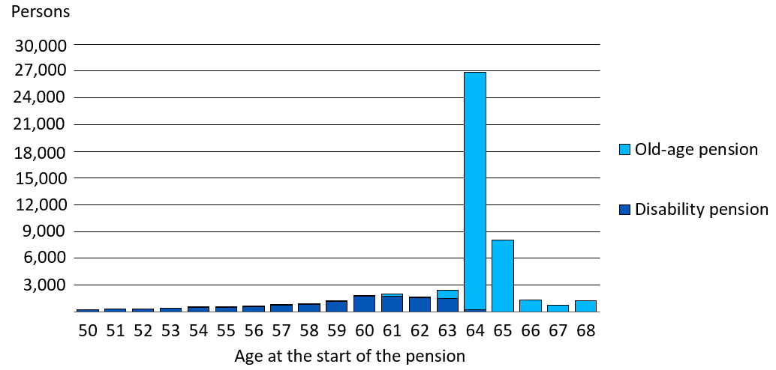
New retirees on an earnings-related pension in 2023, aged 50–68

Slide 33
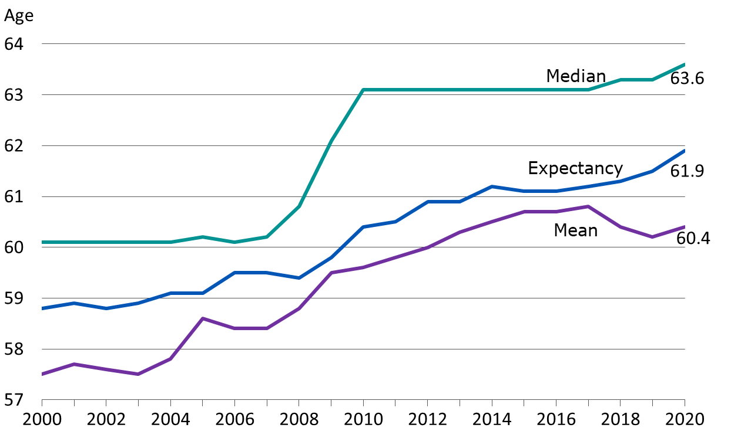
Effective retirement age in earnings-related pension scheme in 2000–2020

Slide 34
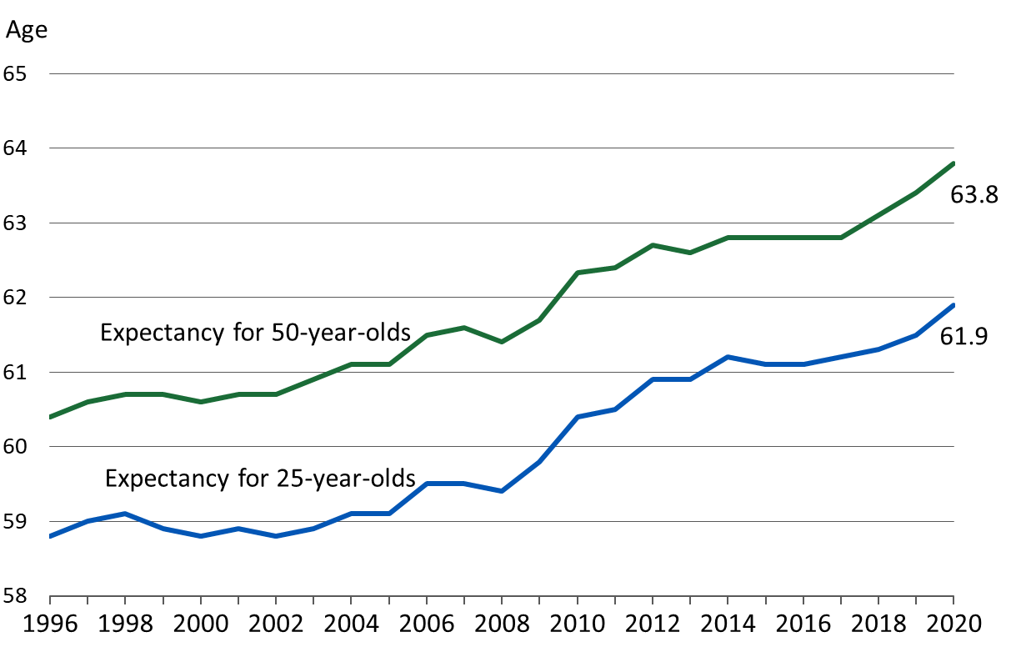
Expected effective retirement age in earnings-related pension scheme in 1996–2020

Slide 35
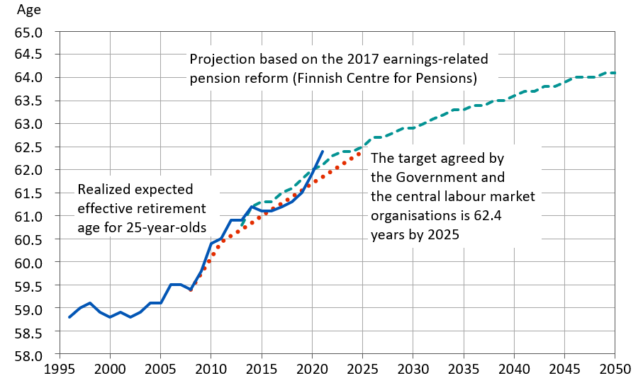
Expected effective retirement age in 1996–2050: realization, target and projection

Slide 36
Financing of Earnings-related Pensions
8

Slide 37
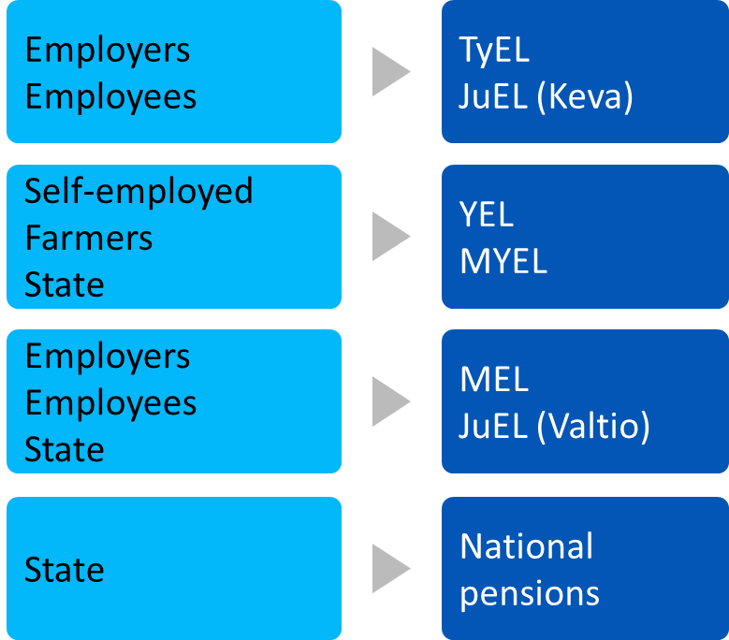
Financing of pensions, by pension act
The Finnish statutory pension provision is financed mainly with earnings-related pension contributions paid by employers, employees, self-employed persons and farmers, as well as a with accrued pension assets and investment returns.
Parts of some of the pensions are financed with state payments and contributions paid by the Employment Fund to the earnings-related pension scheme.
State funds are used to finance the expenses of VEKL benefits relating to the care of one’s own child under the age of three or to studying, as well as relating management expenses.

Slide 38
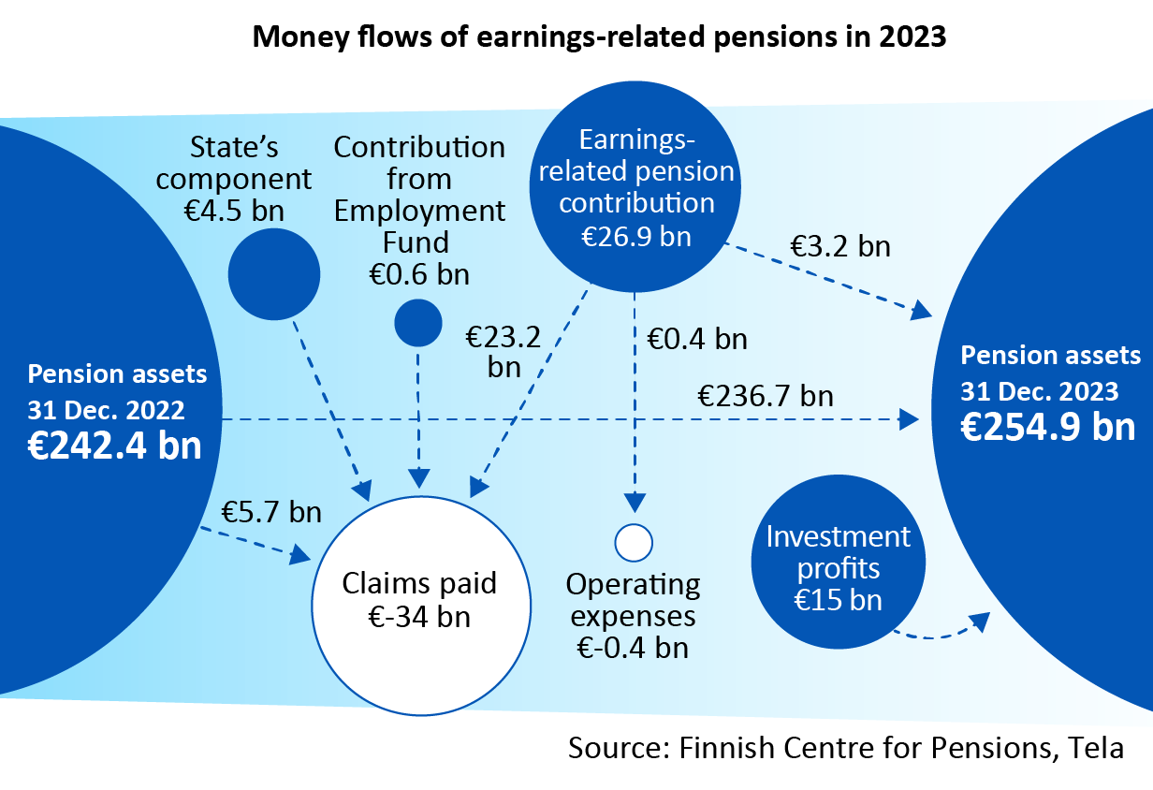
Money flows of earnings-related pension scheme 2023

Slide 39
Earnings-related pension contribution rates in 2024
 | Contributions, % of income from work (estimate) | Eployee’s contribution, % under 53 or above 63 years | Employee’s contribution, % 53-62 years
Employees
TyEL | 24.81 | 7.15 | 8.65
MEL | 19.0 | 7.15 | 8.65
JuEL (municipal sector) | 27.15 | 7.15 | 8.65
JuEL (state) | 24.81 | 7.15 | 8.65
JuEL (church) | 28.97 | 7.15 | 8.65
Self-employed Persons’
YEL | 23.2 | 24.1 ¹⁾ | 25.6 ¹⁾
MYEL | 14.0/13.3 ²⁾ | 24.1 ³⁾ | 25.6 ³⁾
Confirmed YEL contributions.
The average contribution rate of farmers is 14.0 and grant recipients 13.3 per cent.
Confirmed MYEL basic rates.

Slide 40
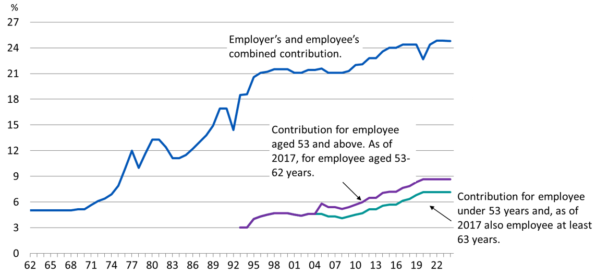
Average TEL-/TyEL contribution in 1962-2024

Slide 41
Earnings-related pension contribution rates
Term | Explanation
TyEL | Employees Pensions Act
MEL | Seafarer’s Pensions Act
JuEL (municipal sector)) | Public Sector Pensions Act (local government employees)
JuEL (state) | Public Sector Pensions Act (State employees)
JuEL (church) | Public Sector Pensions Act (Evangelical Lutheran Church employees)
YEL | Self-employed Persons’ Pensions Act
MYEL | Farmers’ Pensions Act
The Ministry of Social Affairs and Health confirms the earnings-related contribution rates annually.
The contribution rates confirmed for the self-employed and farmers are linked to the average TyEL contribution.
The contribution rate for a self-employed person who has turned 53 is applied as of the beginning of the year after they turn 53 years and continues until the end of the calendar year in which they turn 63 years.
Between 2005 and 2016 the contribution rate of those who had turned 53 years was higher than for younger employees. As of 2017 the contribution rate has been higher for employees aged 53–62 years.
The competitiveness pact that took effect as of the beginning of 2017 resulted in a shift of 0.2 percentage points from the employer’s contribution to the employee’s contribution.

Slide 42
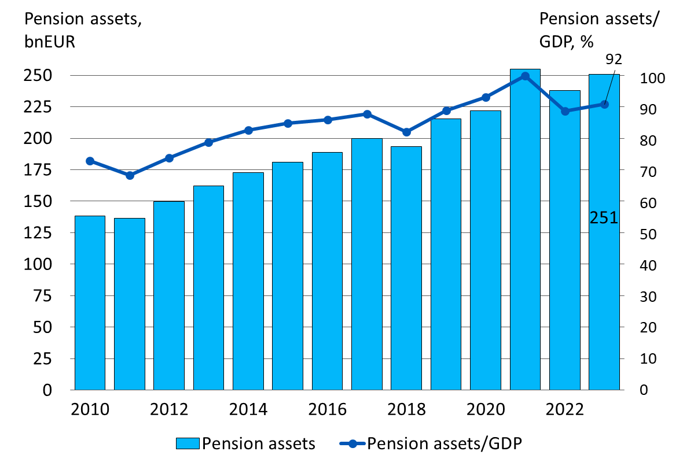
Pension assets and ratio of pension assets to GDP in 2010-2023

