Slide 1
Earnings-related Pension System in Graphs and Figures
The slideshow includes key information of the Finnish earnings-related pension system.
The notes pages of the slides include additional information and links to sources.
30.6.2023

Slide 2
Pension System and Governance
1

Slide 3
Social security insurance in 2021 43 bnEUR
Health Insurance
4.1 bnEUR
Employees’ group life Insurance
0.04 bnEUR
Workers’ Compensation Insurance
0.5 bnEUR
Pension Insurance
33.8 bnEUR
Unemployment Insurance
4.6 bnEUR
National pension
2.5 bnEUR
Earnings-related pension
30.3 bnEUR
Other
1,0 bnEUR

Slide 4
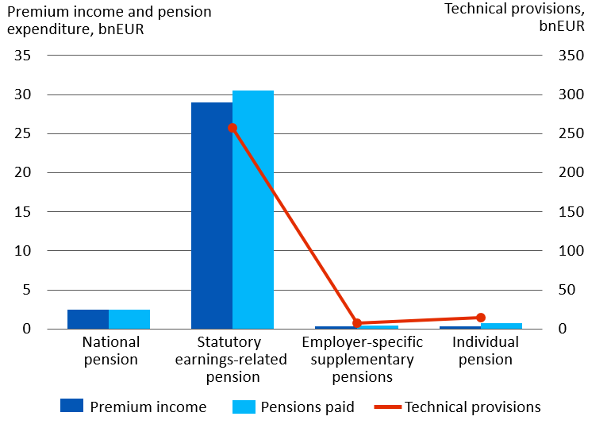
Pension insurance in Finland in 2021

Slide 5
Basic pension provision
Earnings-related
pension
Maintains the attained income level to a reasonable degree
National pension and guarantee pension
Guarantee a minimum income
TOTAL
PENSION
TYÖELÄKE
KANSANELÄKE
JA TAKUUELÄKE
KOKONAIS-
ELÄKE
Vähimmäis-
toimeentulon
turvaaminen

Slide 6
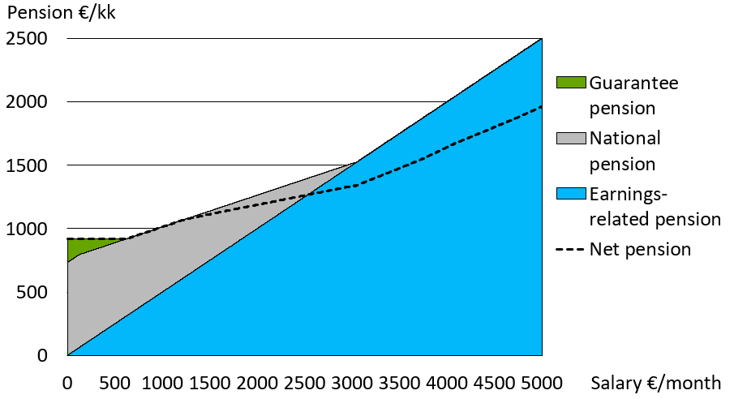
Total pension in 2023
Notes:
Single retiree, earnings-related pension is assumed to be 50 per cent of wages.
The national and guarantee pensions start at the of age 65.
Net pension means the total pension in hand after taxation, assumed that the pension recipient does not have any other income.

Slide 7
Execution in Earnings-related Pension System
Ministry of Social Affairs and Health
Ministry of Finance
Financial Supervisory Authority
Finnish Centre for Pensions
Pension insurance companies
TyEL, YEL (4)
The Farmers' Social Insurance Institution
MYEL
Keva
JuEL
Company pension funds
TyEL (8)
Industry-wide pension funds
TyEL, YEL (4)
Seafarers’ Pension Fund
MEL
Other public partie
Insured and policyholders
Notes:
Situation in the beginning of year 2022.
Other public actors: The Orthodox Church, Bank of Finland, the Government of Åland.
Keva handles the pensions of Kela’s employees.

Slide 8
Preparation and coming into force of earnings-related pension acts
STM
prepares a bill
Employers
Result of the
negotiations
Employees
Parlament
debates the bill
The self-employed
The Finnish pension
Alliance TELA
Authorised pension
providers
STM
The Ministry of
Social Affairs
and Health
ETK
The Finnish Centre for Pensions
The president
ratifies the bill

Slide 9
Determining the Pension
2

Slide 10
Basic pension provision
Earnings-related
pension
Maintains the attained income level to a reasonable degree
National pension and guarantee pension
Guarantee a minimum income
TOTAL
PENSION
TYÖELÄKE
KANSANELÄKE
JA TAKUUELÄKE
KOKONAIS-
ELÄKE
Vähimmäis-
toimeentulon
turvaaminen

Slide 11
Total pension in 2023
Notes:
Single retiree, earnings-related pension is assumed to be 50 per cent of wages.
The national and guarantee pensions start at the of age 65.
Net pension means the total pension in hand after taxation, assumed that the pension recipient does not have any other income.

Slide 12
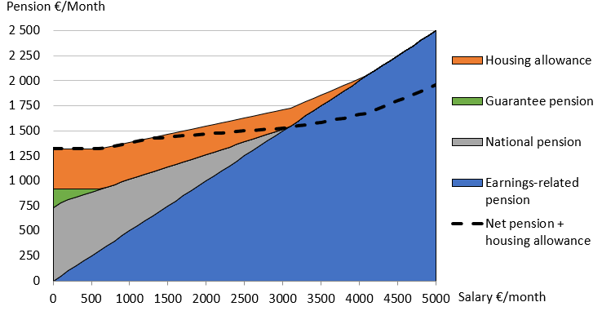
Total pension in 2023, including housing allowance
Notes:
Single retiree, earnings-related pension is assumed to be 50 per cent of wages.
The national and guarantee pensions start at the of age 65.
Net pension means the total pension in hand after taxation, assumed that the pension recipient does not have any other income.

Slide 13
Pension accrues from work
As of the beginning of 2017
ELINAIKA-
KERROIN
Life
expectancy
coefficient
Earnings-
related
pension
Annual
earnings
Accrual
rate
TYÖANSIOT
Pension accrues at a rate of 1.5% of the gross annual wages
For those aged 53–62 years: at a rate of 1.7% of the gross annual wages until the end of 2025 (accrual during transition period).
If the pension is taken after reaching the retirement age, the pension will be increased by 0.4% per month.
Notes:
Pension accrues from the month after the employee turns 17 years and the self-employed person 18 years.
As of 2017, the employee’s earnings-related pension contribution will not be deducted from the wages on which the pension is based.
Pension accrual rates from 2005 to 2016:
1.5% for persons under the age of 53,
1.9% for persons between the ages of 53 and 62 years, and
4.5% for persons between the ages of 63 and 67 years.

Slide 14
Retirement age rises by birth group
Year of birth | Retirement age | Age when insurance obligation and pension accrual end
1954 | 63 years | 68
1955 | 63 years 3 months | 68
1956 | 63 years 6 months | 68
1957 | 63 years 9 months | 68
1958 | 64 years | 69
1959 | 64 years 3 months | 69
1960 | 64 years 6 months | 69
1961 | 64 years 9 months | 69
1962–1964 | 65 years | 70
Notes:
The retirement age of employees born in 1965 and later will be linked to life expectancy. The retirement age will be confirmed by a decree issued by the Ministry of Social Affairs and Health in the year in which the employee turns 62 years.

Slide 15
Age limits of earnings-related pension benefits
Benefit | Year of birth | Right to pension in age
Old-age pension |  | As of age group’s retirement age
Partial old-age pension | 1949–1963 | 61–
 | 1964 | 62–
 | 1965– | 3 years before reaching the retirement age (follows life expectancy)
Disability pension (full or partial) |  | 17– age group’s retirement age
Years-of-service pension | 1955–1964 | 63– age group’s retirement age
 | 1965– | 2 years before reaching the retirement age (follows life expectancy)
Survivor’s pension
- Child |  | 0–18
- Surviving spouse, if children |  | No age limit
- Surviving spouse, no children |  | 50–
Vocational rehabilitation |  | 17– age group’s retirement age

Slide 16
Index adjustments secure pension level
The earnings are adjusted with the wage coefficient to the level of the starting moment of the pension.
Earnings-related pensions in payment are adjusted annually with the earnings-related pension index.
National pensions in payment are adjusted annually by Kela with the national pension index.
Index | 2019 | 2020 | 2021 | 2022 | 2023
Wage coefficient | 1.9% | 2.0% | 1.3% | 2.5% | 3.8%
Earnings-related pension index | 1.5% | 1.2% | 0.5% | 2.3% | 6.8%
National pension index | 0.0% | 1.0% | 0.4% | 2.1% | 7.8%
Notes:
The index adjustment amount is affected by the changes in the consumer price and income level index calculated by Statistics Finland.
In the wage coefficient, the share of change in price level is 20 per cent and the share of wage-earners’ income level is 80 percent.
In the earnings-related pension index, the share of change in price level is 80 per cent and the share of wage-earners’ income level is 20 percent.

Slide 17
Pension Level
3

Slide 18
Average total pension on 31 Dec. 2022
 | Men | Women | All
Average total pension EUR/month | 2,070 | 1,658 | 1,845
- Earnings-related pension component | 1,933 | 1,502 | 1,698
- National pension component | 117 | 143 | 132
- Special protection pension component* | 20 | 12 | 16
Number of pension recipients | 687,000 | 828,000 | 1,515,000
*Occupational Accidents, Injuries and Diseases Act, Motor Liability Insurance Act, Act on Compensation for Military Accidents and Service-Related Illnesses, Act on Compensation for Accidents and Service-Related Illnesses in Crisis Management Duties and the Compensation for Military Injuries Act.
Notes:
Pension recipients: Individuals residing in Finland who receive an old-age, disability or a special pension for farmers from the earnings-related or national pension scheme. Individuals who get a partial old-age pension are not included in the figures.
The total pension includes the pension in one’s own right and survivors’ pension components.
The total pension includes earnings-related pension, national pension, guarantee pension and special protection pensions components.
The total pension is a gross pension.
Statistical database
https://tilastot.etk.fi/pxweb/en/ETK/ETK__110kaikki_elakkeensaajat__20elakkeensaajien_elake/elsael_1k01_laji.px
Statistical Yearbook of Pensioners in Finland
https://www.etk.fi/en/statistics-2/statistics/pension-recipients/all-pension-recipients/

Slide 19
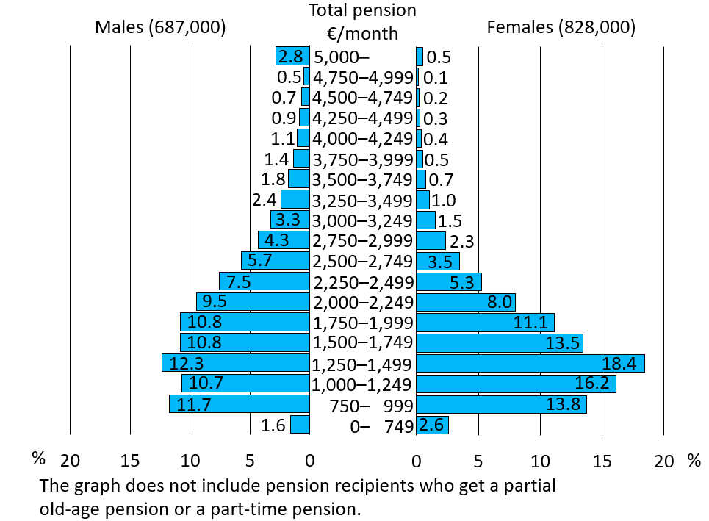
Distribution of total pension received in one’s own right of persons residing in Finland 31 Dec. 2022
Notes:
Pension recipients: Individuals residing in Finland who receive an old-age, disability or a special pension for farmers from the earnings-related or national pension scheme. Individuals who get a partial old-age pension are not included in the figures.
The total pension includes the pension in one’s own right and survivors’ pension components.
The total pension includes earnings-related pension, national pension, guarantee pension and special protection pensions components (Occupational Accidents, Injuries and Diseases Act, Motor Liability Insurance Act, Act on Compensation for Military Accidents and Service-Related Illnesses, Act on Compensation for Accidents and Service-Related Illnesses in Crisis Management Duties and the Compensation for Military Injuries Act).
The total pension is a gross pension.
Statistical database
https://tilastot.etk.fi/pxweb/en/ETK/ETK__110kaikki_elakkeensaajat__20elakkeensaajien_elake/elsael_2k01_laji.Px
Statistical Yearbook of Pensioners in Finland
https://www.etk.fi/en/statistics-2/statistics/pension-recipients/all-pension-recipients/

Slide 20
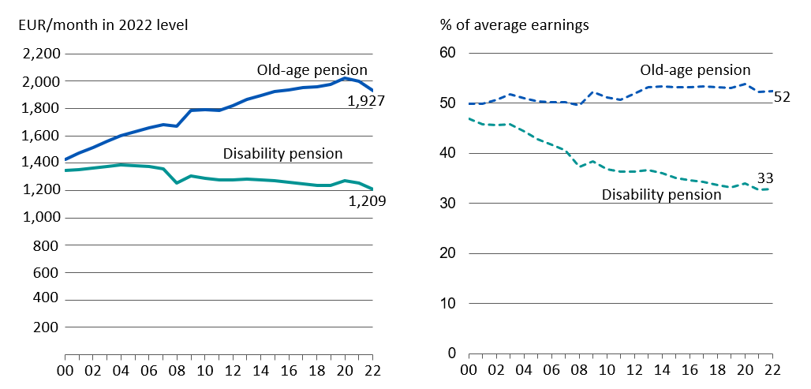
Average total pension and its ratio to average earnings in 2000–2022
Notes:
Pension recipients: Individuals residing in Finland who receive an old-age or disability pension from the earnings-related or national pension scheme.
The total pension includes the pension in one’s own right and survivors’ pension components.
The total pension includes earnings-related pension, national pension, guarantee pension and special protection pensions components (Occupational Accidents, Injuries and Diseases Act, Motor Liability Insurance Act, Act on Compensation for Military Accidents and Service-Related Illnesses, Act on Compensation for Accidents and Service-Related Illnesses in Crisis Management Duties and the Compensation for Military Injuries Act).
As of year 2008, the total pension no longer includes pensioners’ housing and care allowance components. As of 2011, the total pension includes the guarantee pension component.
The total pension is a gross pension.
The average earning is based on the Income distribution statistics of Statistics Finland, which contains data on average earned and entrepreneurial incomes.

Slide 21
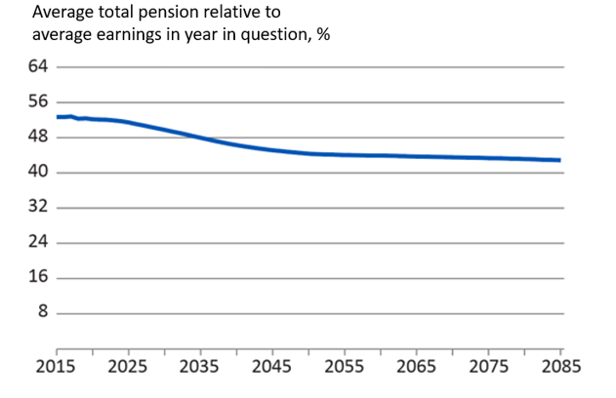
Average total pension relative to average earnings in 2015–2085, %
Notes:
https://www.etk.fi/en/research-statistics-and-projections/projections/long-term-projections/
Pension recipients: Individuals residing in Finland who receive an old-age, disability or a special farmer’s pension from the earnings-related or national pension scheme.
The total pension includes the pension in one’s own right and survivors’ pension components.
The total pension includes earnings-related pension, national pension, guarantee pension and special protection pensions components (Occupational Accidents, Injuries and Diseases Act, Motor Liability Insurance Act, Act on Compensation for Military Accidents and Service-Related Illnesses, Act on Compensation for Accidents and Service-Related Illnesses in Crisis Management Duties and the Compensation for Military Injuries Act).
The average earning is based on data on the insured individuals’ income from work and the number of insured in the earnings and accrual register of the earnings-related pension system.

Slide 22
Pension Expenditure
4

Slide 23
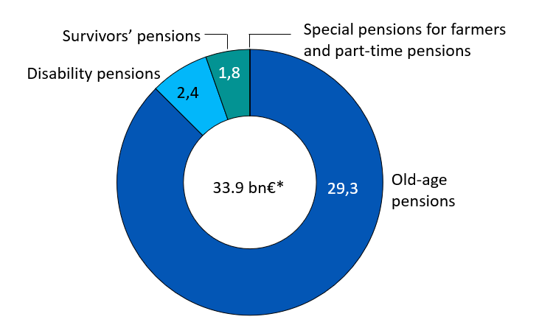
Earnings-related and Kela pension expenditure in 2022
*Includes the guarantee pensions (273 mill. EUR) and the front-veterans supplements and the child increases (11 mill. EUR) paid by Kela.
Notes:
Special pensions for farmers 27 mill.€, part-time pensions 1 mill.€.
Statistical database
https://tilastot.etk.fi/pxweb/en/ETK/ETK__140elakemenot/emeno03_laji.px

Slide 24
Statutory total pension expenditure in 2015–2022, mEUR
 | 2015 | 2016 | 2017 | 2018 | 2019 | 2020 | 2021 | 2022*
Earnings-related pensions | 25,265 | 26,035 | 27,034 | 27,865 | 28,858 | 29,671 | 30,309 | 31,400
- Private sector | 15,944 | 16,442 | 17,086 | 17,619 | 18,246 | 18,751 | 19,142 | 19,830
- Public sector | 9,321 | 9,593 | 9,947 | 10,246 | 10,612 | 10,920 | 11,167 | 11,570
Kela’s pensions | 2,503 | 2,470 | 2,391 | 2,357 | 2,324 | 2,515 | 2,461 | 2,477
Special protection pensions** | 501 | 494 | 472 | 462 | 455 | 448 | 437 | ..
Total pension expenditure | 28,269 | 28,999 | 29,897 | 30,684 | 31,637 | 32,634 | 33,207 | 34,933
* Preliminary data
** Occupational Accidents, Injuries and Diseases Act, Motor Liability Insurance Act, Act on Compensation for Military Accidents and Service-Related Illnesses, Act on Compensation for Accidents and Service-Related Illnesses in Crisis Management Duties and the Compensation for Military Injuries Act.
Notes:
The total pension expenditure includes old-age, disability, survivors’ and part-time pensions, as well as special pensions for farmers, paid from different pension systems.
Kela’s pension expenditure includes national pensions, guarantee pensions, front-veterans supplements and child increases.
Statistical database
https://tilastot.etk.fi/pxweb/en/ETK/ETK__140elakemenot/emeno01_koko.px

Slide 25
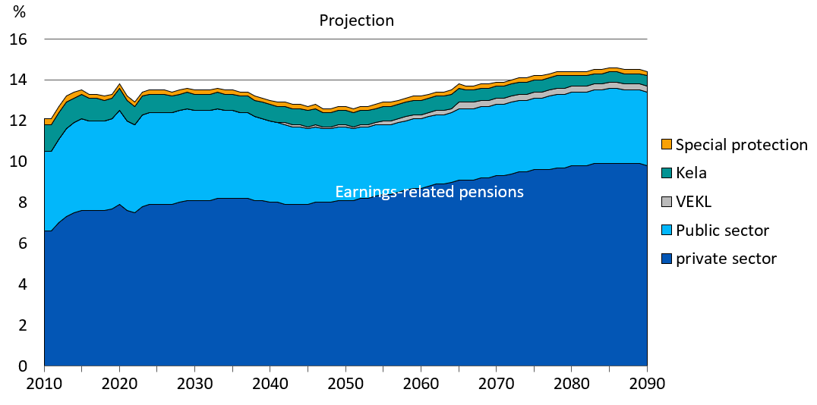
Pension expenditure, per cent of GDP in 2010–2090
Notes:
https://www.etk.fi/en/forecasts/forecasts/long-term-projections/
Kela’s pension expenditure includes national and guarantee pensions.
Special protection = Occupational Accidents, Injuries and Diseases Act, Motor Liability Insurance Act, Act on Compensation for Military Accidents and Service-Related Illnesses, Act on Compensation for Accidents and Service-Related Illnesses in Crisis Management Duties and the Compensation for Military Injuries Act.
VEKL: Act on Compensation for Pension Accrual from State Funds for Periods of Childcare and Periods of Study

Slide 26
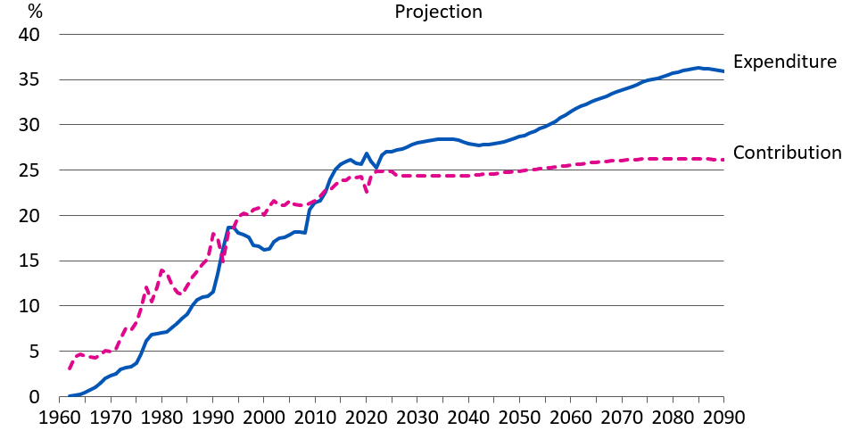
Pension expenditure and contribution rates in proportion to the wage sum under the Employees Pensions Act (TyEL) in 1962–2090
Notes:
https://www.etk.fi/en/forecasts/forecasts/long-term-projections/
The realised and projected development of private-sector employees’ pension expenditure and contributions in proportion to the equivalent wage sum.

Slide 27
Insured for Earnings-related Pension Benefits
5

Slide 28
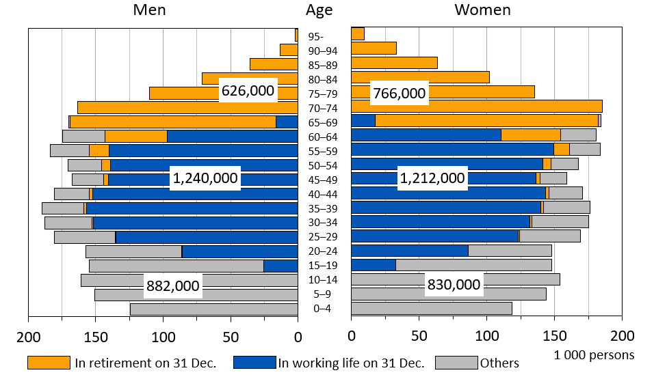
Distribution of population in terms of work and earnings-related pension per 31 Dec. 2021

Slide 29
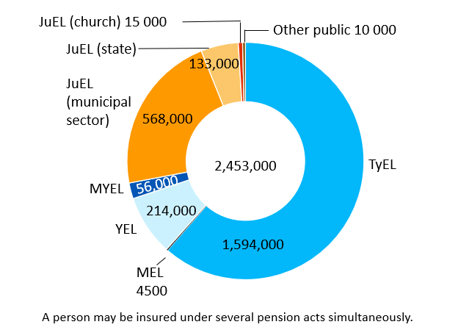
Insured persons in employment or self employment on 31 Dec. 2021, by pension act
Notes:
The figures depict the number of individuals in employment or self-employment on 31 December.
A person may be insured under several different pension acts simultaneously. In the total amount (2.5 million), each individual is counted only once.
JuEL (Municipal Sector) covers 42,000 elected officials, family caregivers, private care-providers etc.
JuEL (State) covers 8,000 elected officials, consultants etc.
TyEL = Employees Pensions Act
MEL = Seafarer’s Pensions Act
YEL = Self-employed Persons’ Pensions Act
MyEL = Farmers’ Pensions Act
JuEL= Public Sector Pensions Act (Municipal Sector, State, Church)
OrtKL = Orthodox Church Act
SP = Pension regulation for the Bank of Finland
Pension regulation for the regional government of Åland
Statistical database
https://tilastot.etk.fi/pxweb/en/ETK/ETK__170vakuutetut__10tyoelakevakuutetut/vak01_piiri.px
Persons insured for an earnings-related pension in Finland
https://www.etk.fi/en/statistics-2/statistics/insured-persons/

Slide 30
Pension Recipients
6

Slide 31
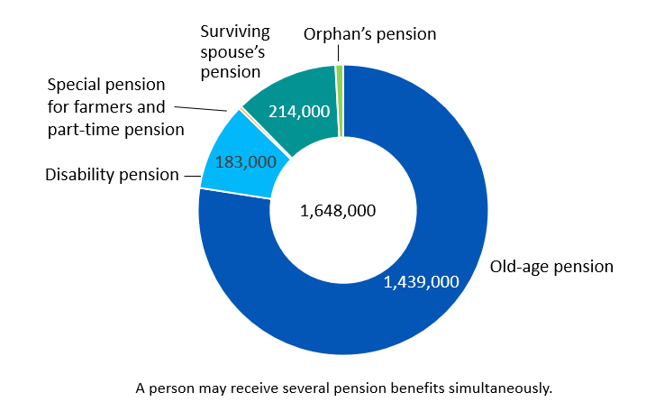
All pension recipients on 31 Dec. 2022
Notes:
Part-time pension 30, special pension for farmers (farm closure pension and farmers’ early retirement aid) 6,000, orphan’s pension 16,000.
The figures include all individuals receiving a pension from the earnings-related or national pension scheme.
1,596,000 pension recpients resided in Finland while 52,000 resided abroad.
Statistical database
https://tilastot.etk.fi/pxweb/en/ETK/ETK__110kaikki_elakkeensaajat__20elakkeensaajien_elake/elsael_1k01_laji.px
Statistical Yearbook of Pensioners in Finland
https://www.etk.fi/en/statistics-2/statistics/pension-recipients/all-pension-recipients/

Slide 32
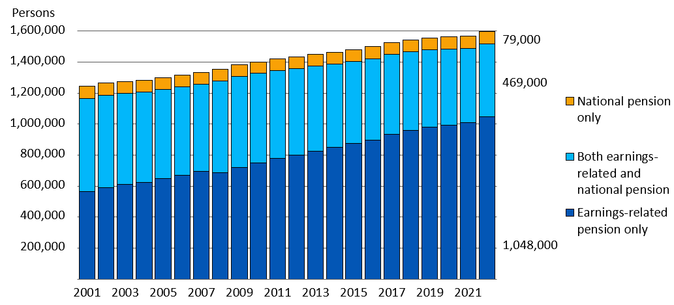
Pension recipients by pension structure in 2001–2022
Notes:
The figures in the graph include all pension recipients residing in Finland receiving pension from the statutory earnings-related or national pension scheme.
Statistical database
https://tilastot.etk.fi/pxweb/en/ETK/ETK__110kaikki_elakkeensaajat__10elakkeensaajien_lkm/elsa_k04_rak.px
Statistical Yearbook of Pensioners in Finland
https://www.etk.fi/en/statistics-2/statistics/pension-recipients/all-pension-recipients/

Slide 33
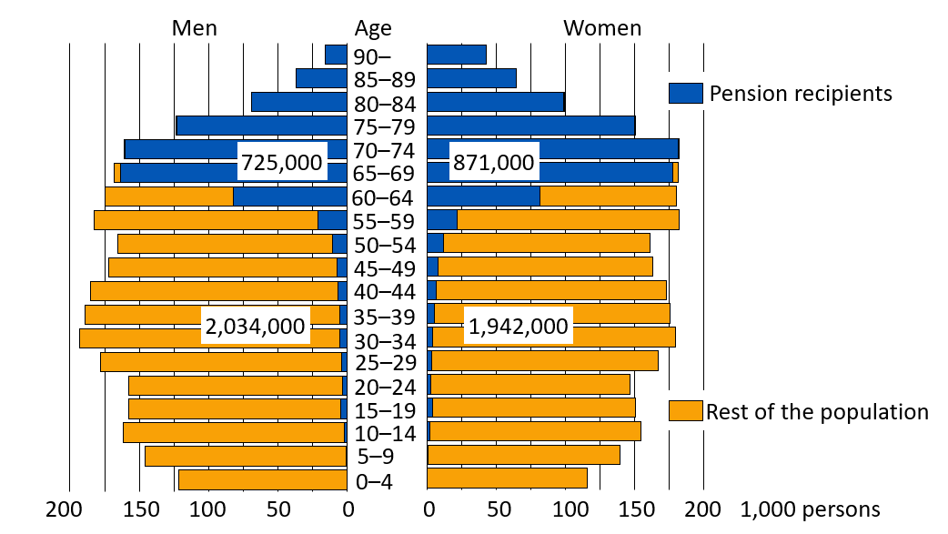
Total population and pension recipients on 31 Dec. 2022
Notes:
Pension recipients: individuals residing in Finland who receive an old-age, disability, survivors’ and part-time pension, as well as farmer’s special pension, paid from the statutory earnings-related or national pension scheme.
Population: Population insured by Kela
Statistical database
https://tilastot.etk.fi/pxweb/en/ETK/ETK__110kaikki_elakkeensaajat__10elakkeensaajien_lkm/elsa_k02_laji.px
Statistical Yearbook of Pensioners in Finland
https://www.etk.fi/en/statistics-2/statistics/pension-recipients/all-pension-recipients/

Slide 34
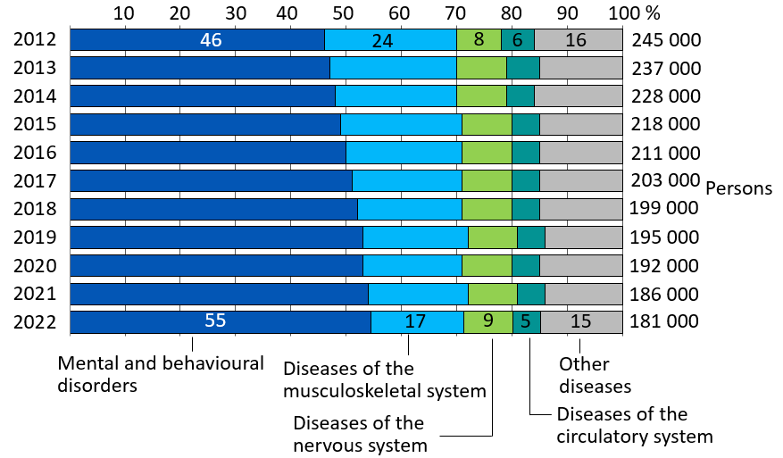
Recipients of disability pension by main disease category in 2012–2022
Notes:
The figures include individuals residing in Finland who have received a disability pension from the statutory earnings-related or national pension scheme.
The disability pensions include the actual disability pensions and the individual early retirement pensions (in 2010).
Actual disability pension: A pension granted until further notice or a cash rehabilitation benefit (fixed-term disability pension). Both can be granted allso to the amount of a partial pension in the earnings-related pension scheme.
Statistical database
https://tilastot.etk.fi/pxweb/en/ETK/ETK__110kaikki_elakkeensaajat__10elakkeensaajien_lkm/elsa_k10_tk_diag.px
Statistical Yearbook of Pensioners in Finland
https://www.etk.fi/en/statistics-2/statistics/pension-recipients/all-pension-recipients/

Slide 35
Retirees on Earnings-related Pensions and Effective Retirement Age
7

Slide 36
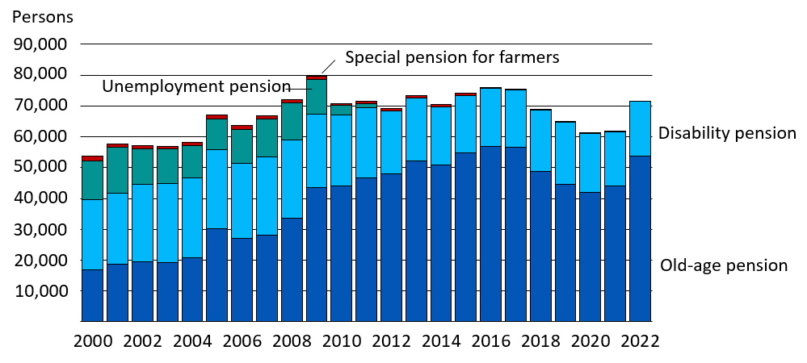
New retirees on earnings-related pension in 2000–2022, by pension benefit
Notes:
The numbers in the figure refer to new retirees on a statutory earnings-related pension.
New retirees on the old-age pension includes only individuals who have retired directly on an old-age pension or whose part-time pension has been converted to an old-age pension.
Individuals who have retired on the partial old-age pension (taking out 25% or 50% of their accrued pension) are not considered new retirees. They will be included in the figure for new retirees on an old-age pension when they retire on a full old-age pension.
Statistical database
https://tilastot.etk.fi/pxweb/en/ETK/ETK__120tyoelakkeensaajat__40tyoelakkeelle_siirtyneiden_lkm/elsi_t01_laji.px
Earnings-related pension recipients in Finland
https://www.etk.fi/en/statistics-2/statistics/pension-recipients/earnings-related-pension-recipients/

Slide 37
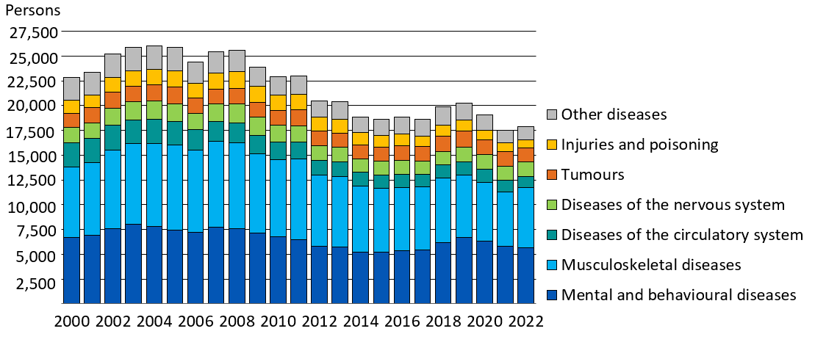
New retirees on an earnings-related disability pension in 2000–2022, by main disease category
Notes:
The figures in the graph concerns individuals who have retired on a statutory earnings-related pension.
The disability pensions include the actual disability pensions and the individual early retirement pensions (in 2000–2006).
Actual disability pension: a pension granted until further notice and a cash rehabilitation benefit (fixed-term disability pension). Both can be granted allso to the amount of a partial pension.
Statistical database
https://tilastot.etk.fi/pxweb/en/ETK/ETK__120tyoelakkeensaajat__40tyoelakkeelle_siirtyneiden_lkm/elsi_t10_tk_diag.px
Earnings-related pension recipients in Finland
https://www.etk.fi/en/statistics-2/statistics/pension-recipients/earnings-related-pension-recipients/

Slide 38
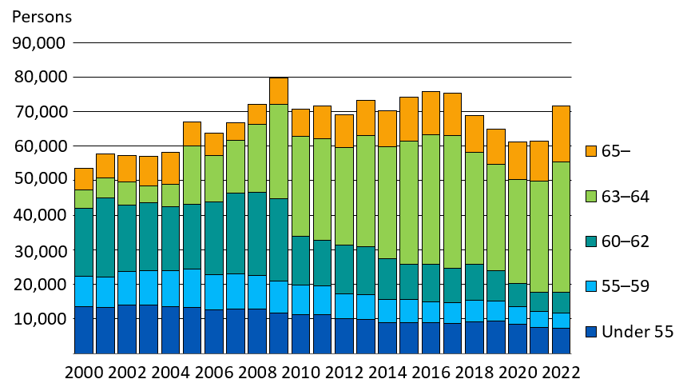
New retirees on an earnings-related pension in 2000–2022, by age group
Notes:
The figures in the graph concerns individuals who have retired on a statutory earnings-related pension.
New retirees on old-age pension (includes only persons who have retired directly on old-age pension or whose part-time pension has been converted to an old-age pension), disability pension, unemployment pension (2000–2011) and special pension for farmers.
Individuals who have retired on a part-time pension are not counted as new retirees since receiving part-time pension requires working.
Individuals who have retired on a partial old-age pension (taking out 25% or 50% of their accrued pension) are not considered new retirees. They will be included in the figure for new retirees on an old-age pension when they retire on a full old-age pension.
Statistical database
https://tilastot.etk.fi/pxweb/en/ETK/ETK__120tyoelakkeensaajat__40tyoelakkeelle_siirtyneiden_lkm/elsi_t01_laji.px
https://tilastot.etk.fi/pxweb/en/ETK/ETK__130elakkeellesiirtymisika/esiirtymisika02.px
Earnings-related pension recipients in Finland
https://www.etk.fi/en/statistics-2/statistics/pension-recipients/earnings-related-pension-recipients/

Slide 39
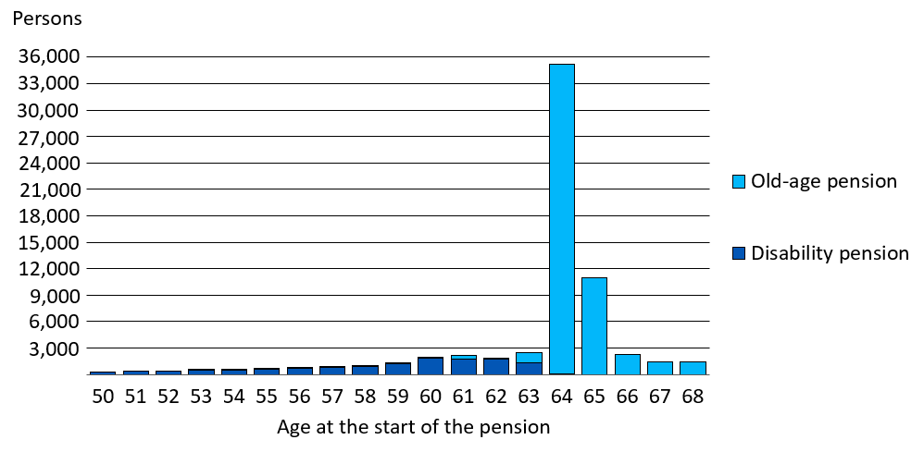
New retirees on an earnings-related pension in 2022, aged 50–68
Notes:
The figures in the graph concerns individuals who have retired on a statutory earnings-related pension.
Individuals who have retired on a partial old-age pension (taking out 25% or 50% of their accrued pension) are not considered new retirees. They will be included in the figure for new retirees on an old-age pension when they retire on a full old-age pension.
Statistical database
https://tilastot.etk.fi/pxweb/en/ETK/ETK__120tyoelakkeensaajat__40tyoelakkeelle_siirtyneiden_lkm/elsi_t01_laji.Px

Slide 40
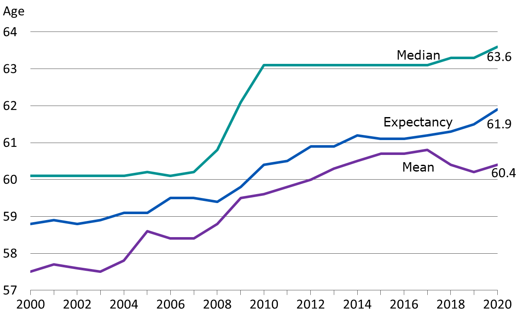
Effective retirement age in earnings-related pension scheme in 2000–2020
Notes:
The figures in the graph concerns individuals who have retired on a statutory earnings-related pension.
New retirees on old-age pension (includes only persons who have retired directly on old-age pension or whose part-time pension has been converted to an old-age pension), disability pension, unemployment pension (2000–2011) and special pension for farmers.
The figures in the graph do not include new retirees on a part-time pension or a partial old-age pension.
The median age is the middle observation of the data, i.e. half of the new retirees are younger than this while half are older.
The mean age is the arithmetical average age of the new retirees.
The expected effective retirement age is an indicator developed a longside the traditional average and median age. It is better suited to monitor the changes in retirement ages. The expected effective retirement age is the average retirement age, which is formed for insured individuals of a certain age if the age-cohort-specific retirement and mortality rates remain at the level of the review year. The expectancy is independent of age structure. In the graph, the expected effective retirement age has been calculated for a 25-year-old, and it depicts the retirement age of the entire population insured for an earnings-related pension.
Statistical database
https://tilastot.etk.fi/pxweb/en/ETK/ETK__130elakkeellesiirtymisika/esiirtymisika01.px
Effective retirement age
https://www.etk.fi/en/statistics-2/statistics/effective-retirement-age/

Slide 41
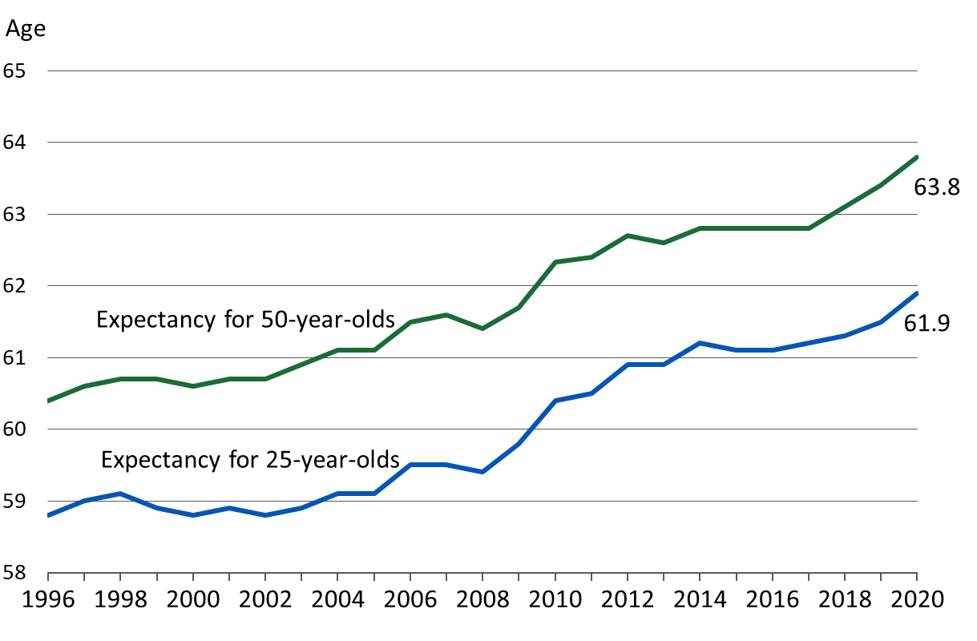
Expected effective retirement age in earnings-related pension scheme in 1996–2020
Notes:
The expected effective retirement age is an indicator developed alongside the traditional average and median age. It is better suited to monitor the changes in retirement ages.
The expected effective retirement age is the average retirement age, which is formed for insured individuals of a certain age if the age-cohort-specific retirement and mortality rates remain at the level of the review year. The expectancy is independent of age structure.
In the graph, the expected effective retirement age has been calculated for a 25-year-old and a 50-year-old separately. The expectancy for the 25-year-old depicts the retirement age of the entire population insured for an earnings-related pension. The expectancy for a 50-year-old has been calculated based on all insured aged 50.
Statistical database
https://tilastot.etk.fi/pxweb/en/ETK/ETK__130elakkeellesiirtymisika/esiirtymisika01.px
Effective retirement age
https://www.etk.fi/en/statistics-2/statistics/effective-retirement-age/

Slide 42
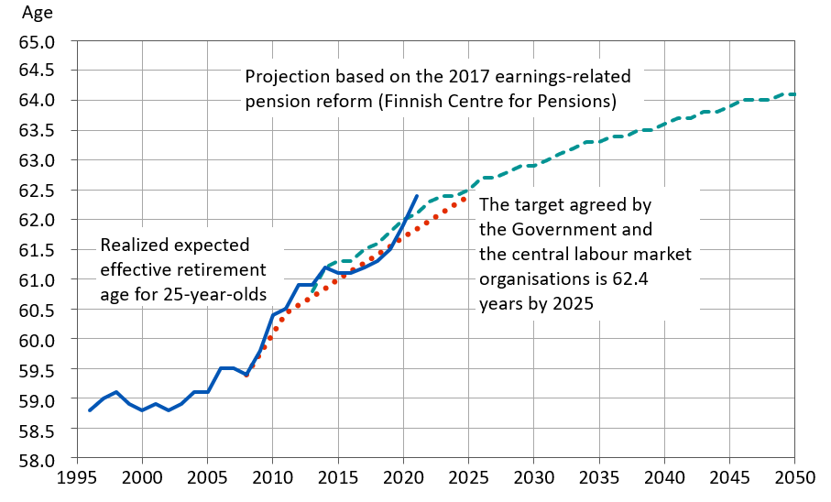
Expected effective retirement age in 1996–2050: realization, target and projection
Notes:
Pension Indicators
https://www.etk.fi/en/julkaisu/pension-indicators

Slide 43
Rehabilitation within the Earnings-related Pension Scheme
8

Slide 44
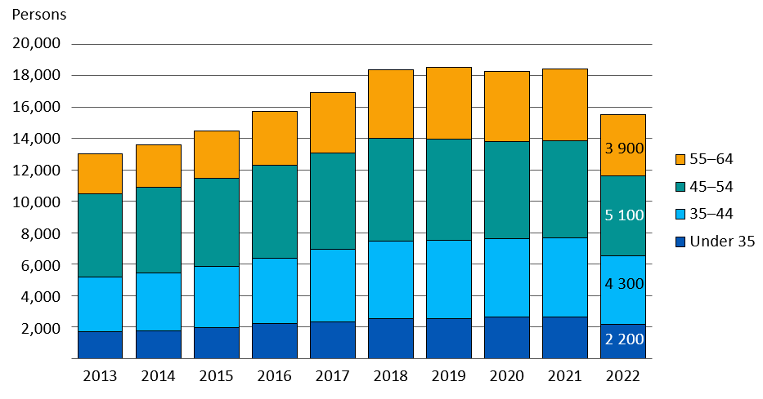
Rehabilitees by age in 2013–2022
Notes:
In 2021, the average age of rehabilitees was 47. Of all rehabilitees, 55 per cent were women.
Statistical database
https://tilastot.etk.fi/pxweb/en/ETK/ETK__160tyoelakekuntoutus/kuntoutus01.Px
Rehabilitation
https://www.etk.fi/en/statistics-2/statistics/rehabilitation/

Slide 45
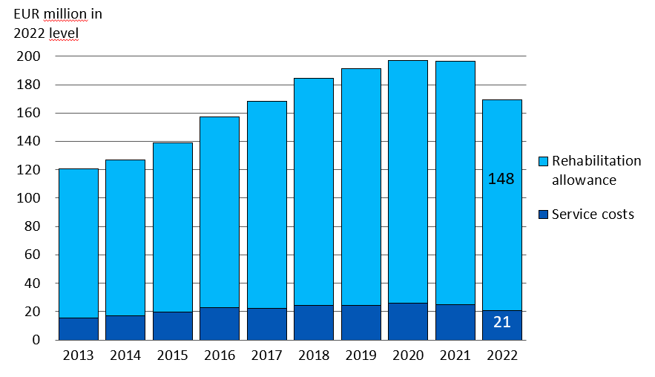
Rehabilitation expenses in 2013–2022
Notes:
The total rehabilitation expenses consist of the income compensation paid during rehabilitaiton (rehabilitation assistance, rehabilitation allowance, rehabilitation increment) and rehabilitation service expenses. In 2021, the average income compensation was EUR 2,896 /month.
Statistical database
https://tilastot.etk.fi/pxweb/en/ETK/ETK__160tyoelakekuntoutus/kuntoutus02.px
Rehabilitation
https://www.etk.fi/en/statistics-2/statistics/rehabilitation/

Slide 46
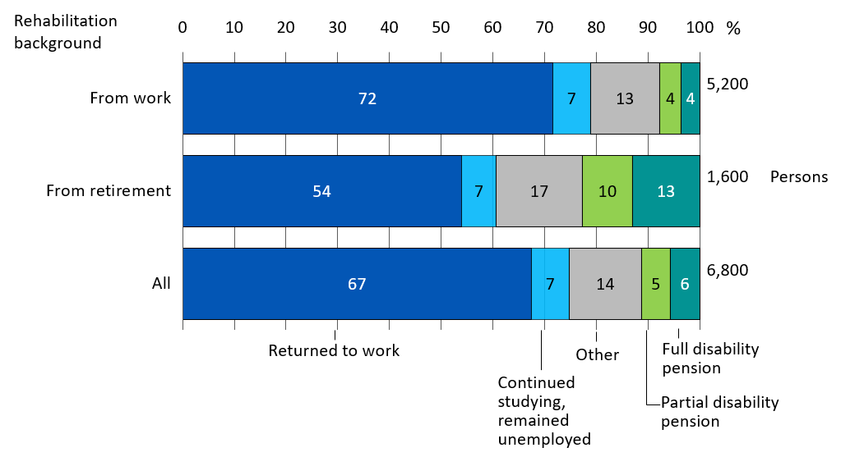
Post-rehabilitation status in 2022

Slide 47
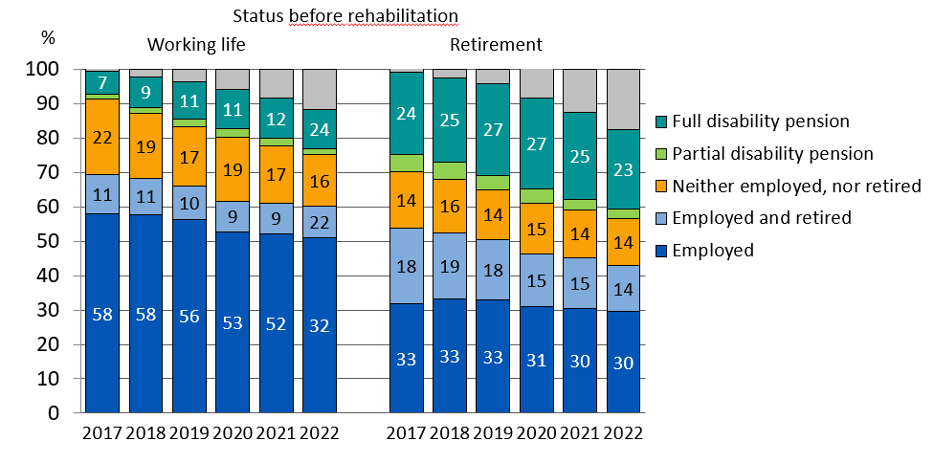
Continuing at work, employees ending rehabilitation in 2017
Notes:
The graph depicts the status (mainly in terms of the permanence of employment or retirement) of individuals whose rehabilitation ended in 2017. The data is based on the registers of the Finnish Centre for Pensions.
Employed: The individual is only employed.
Employed and retired: The individual works while being retired. The pension received may be a partial or full disability pension or some other form of pension.
Neither employed nor retired: The individual is unemployed or studies.
Partial disability pension, full disability pension: The individual is only retired and not in employment.
Other: Other pension than disability pension (not in employment), dead.

Slide 48
Financing of Earnings-related Pensions
9

Slide 49
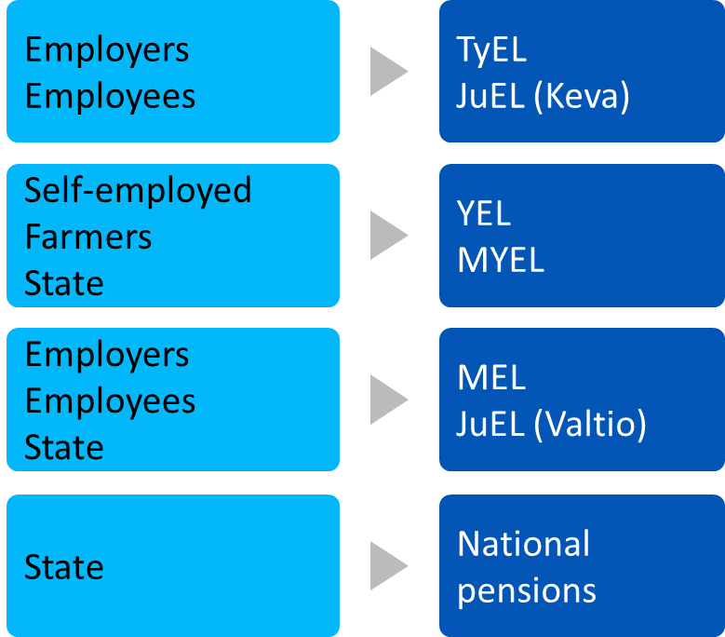
Financing of pensions, by pension act
The Finnish statutory pension provision is financed mainly with earnings-related pension contributions paid by employers, employees, self-employed persons and farmers, as well as a with accrued pension assets and investment returns.
Parts of some of the pensions are financed with state payments and contributions paid by the Employment Fund to the earnings-related pension scheme.
State funds are used to finance the expenses of VEKL benefits relating to the care of one’s own child under the age of three or to studying, as well as relating management expenses.

Slide 50
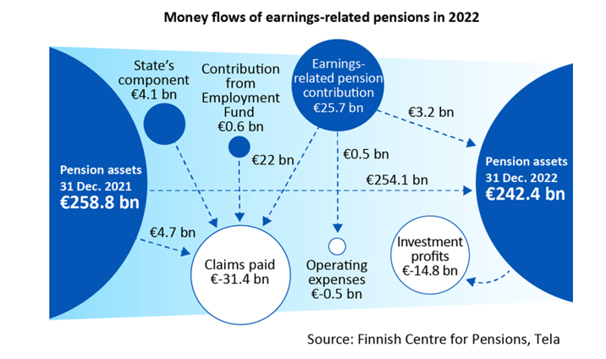
Money flows of earnings-related pension scheme 2022
Notes:
The Finnish statutory pension provision is financed mainly with earnings-related pension contributions paid by employers, employees, self-employed persons and farmers, as well as a with accrued pension assets and investment returns.
Parts of some of the pensions are financed with state payments and contributions paid by the Unemployment Insurance Fund (from 2019 Employment Fund) to the earnings-related pension scheme.
Statistical database
https://tilastot.etk.fi/pxweb/en/ETK/ETK__180tyoelakkeiden_rahoitus__10rahavirrat/rahavirrat01_kaikki.px

Slide 51
Earnings-related pension contribution rates in 2023
 | Contributions, % of income from work (estimate) | Eployee’s contribution, % under 53 or above 63 years | Employee’s contribution, % 53-62 years
Palkansaajat
TyEL | 24.84 | 7.15 | 8.65
MEL | 19.0 | 7.15 | 8.65
JuEL (Keva) | 24.4 | 7.15 | 8.65
JuEL (valtio) | 24.84 | 7.15 | 8.65
JuEL (kirkko) | 28.7 | 7.15 | 8.65
Yrittäjät
YEL | 23.0 | 24.1 ¹⁾ | 25.6 ¹⁾
MYEL | 14.0/13.3 ²⁾ | 24.1 ³⁾ | 25.6 ³⁾
Confirmed YEL contributions.
The average contribution rate of farmers is 14.0 and grant recipients 13.3 per cent.
Confirmed MYEL basic rates.
Notes:
TyEL = Employees Pensions Act
MEL = Seafarer’s Pensions Act
JuEL (municipal sector)) = Public Sector Pensions Act (local government employees)
JuEL (state) = Public Sector Pensions Act (State employees)
JuEL (church) = Public Sector Pensions Act (Evangelical Lutheran Church employees)
YEL = Self-employed Persons’ Pensions Act
MYEL = Farmers’ Pensions Act
The Ministry of Social Affairs and Health confirms the earnings-related contribution rates annually.
JuEL (municipal sector) contribution includes the components based on wage and pension expenditure.
In addition to the Church contribution, a pension fund contribution. In 2022, it is 5% of the Church tax.
The contribution rates confirmed for the self-employed and farmers are linked to the average TyEL contribution.
The contribution rate for a self-employed person who has turned 53 is applied as of the beginning of the year after they turn 53 years and continues until the end of the calendar year in which they turn 63 years.

Slide 52
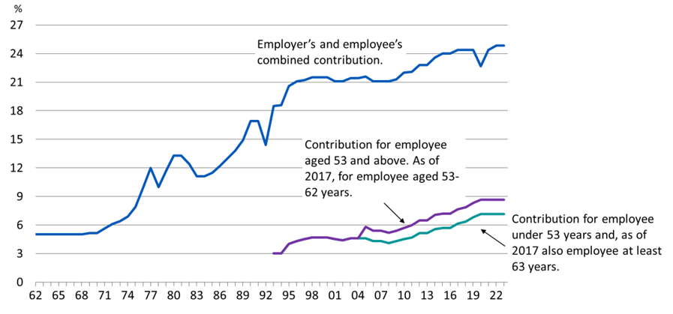
Average TEL-/TyEL contribution in 1962-2023

Slide 53
Earnings-related pension contribution rates
Term | Explanation
TyEL | Employees Pensions Act
MEL | Seafarer’s Pensions Act
JuEL (municipal sector)) | Public Sector Pensions Act (local government employees)
JuEL (state) | Public Sector Pensions Act (State employees)
JuEL (church) | Public Sector Pensions Act (Evangelical Lutheran Church employees)
YEL | Self-employed Persons’ Pensions Act
MYEL | Farmers’ Pensions Act
The Ministry of Social Affairs and Health confirms the earnings-related contribution rates annually.
The contribution rates confirmed for the self-employed and farmers are linked to the average TyEL contribution.
The contribution rate for a self-employed person who has turned 53 is applied as of the beginning of the year after they turn 53 years and continues until the end of the calendar year in which they turn 63 years.
Between 2005 and 2016 the contribution rate of those who had turned 53 years was higher than for younger employees. As of 2017 the contribution rate has been higher for employees aged 53–62 years.
The competitiveness pact that took effect as of the beginning of 2017 resulted in a shift of 0.2 percentage points from the employer’s contribution to the employee’s contribution.

Slide 54
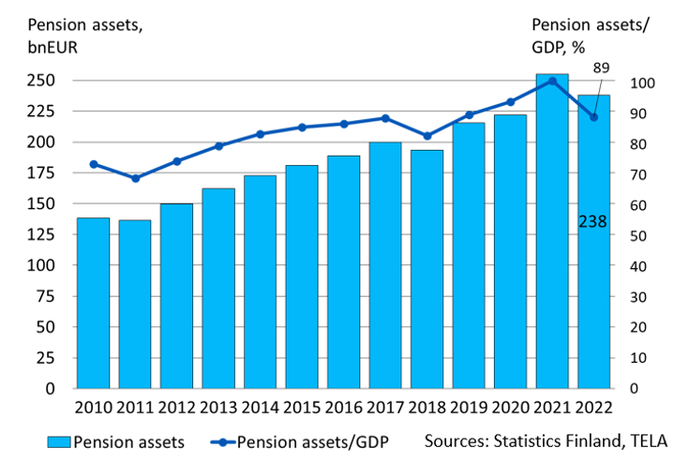
Pension assets and ratio of pension assets to GDP in 2010-2022
Notes:
Sources:
GDP: Statistics Finland
Pension Assets: The Finnish Pension Alliance TELA

